Slide 1
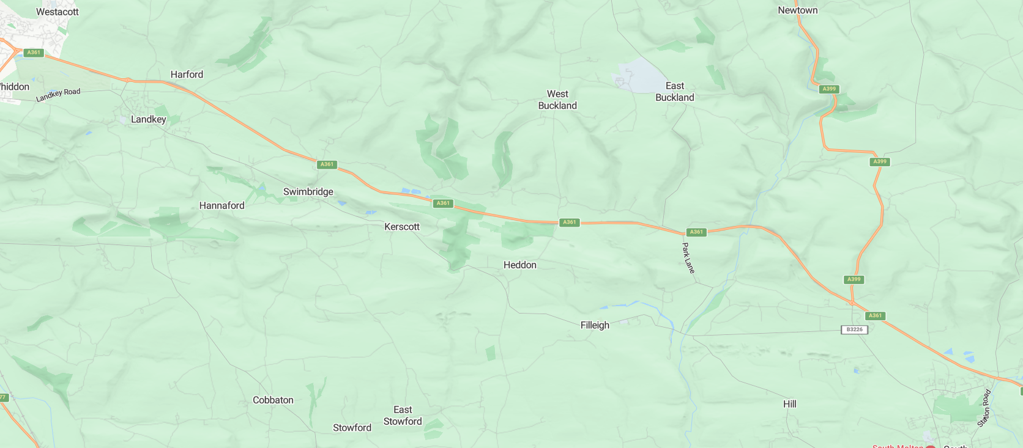
No road closures of the A361 are planned. Traffic management will be deployed for the following times: -- Sun-Mon 20:00hrs to 06:00hrs -- Mon-Tue 20:00hrs to 06:00hrs -- Tue-Wed 20:00hrs to 06:00hrs -- Wed-Thu 20:00hrs to 06:00hrs -- Thu-Fri 20:00hrs to 06:00hrs -- Fri-Sat 20:00hrs to 06:00hrs All traffic management will be removed during the daytime throughout the week. Traffic management being used will include: -- 2-way temporary traffic lights which will be attended to minimise disruption -- 3-way temporary traffic lights which will be attended to minimise disruption -- lane closures on widened sections which will maintain the flow of traffic in both directions -- two lanes on the roundabouts at Landkey and Borners bridge will be reduced to a single lane with cones
North Devon Link Road
Traffic Bulletin
April 2025
Our Public Liaison Officer, Caroline Cann can be contacted on:
E: NDLR@alungriffiths.co.uk
T: 01633 848 223*
Calls are monitored out of normal work hours and a voicemail facility is available. Please check out our project website:
community.alungriffiths.co.uk
If you would like to subscribe to receive future Newsletters and Bulletins, use this QR code:
2-WAY TRAFFIC LIGHTS
PORTMORE ROUNABOUT
LANE CLOSURE
LANDKEY ROUNDABOUT
LANE CLOSURE + TRAFFIC LIGHTS
3-WAY TRAFFIC LIGHTS
LANE CLOSURE
WEST BUCKLAND JUNCTION
BORNERS BRIDGE ROUNDABOUT
NORTH ALLER ROUNDABOUT

